Slide 1

Student Depression Dataset Analyzing Mental Health Trends and Predictors Among Students
By: Seth Harris, Joaquin Ramirez, & Leonel Salazar

Slide 2

The Business Challenge
Research Question:
What are the most significant predictors of depression among university students, and how can they inform targeted mental health interventions?
Purpose:
The goal of this analysis is to evaluate key predictors of depression among students such as demographics, academic stress, lifestyle habits, and psychological indicators.
Notes:
Student mental health is a significant concern, affecting a substantial portion of the student population. Approximately 76% of college students experience moderate to serious psychological distress, and a concerning number report high stress levels, feelings of loneliness, and suicidal ideation. Mental health challenges can have a profound impact on academic performance, social well-being, and overall quality of life for students.
The purpose of this analysis was to identify key predictors of depression among university students using a logistic regression model. The goal was to build a model capable of predicting the likelihood that a student is suffering from depression, based on various demographic, academic, lifestyle, and psychological factors. This information could then be used to inform targeted interventions and mental health support programs, addressing students' unique needs and challenges.
We aim to build a reliable logistic regression model for early detection of at-risk individuals and support targeted mental health interventions.

Slide 3
Dataset Overview
Source: Kaggle
Predictors
27,901 university student records
Outcome Variable: Depression (1 = Depressed, 0 = Not Depressed)
https://www.kaggle.com/datasets/adilshamim8/student-depression-dataset
Demographics
(Age, Gender, City)
Academics
(CGPA, Work Pressure, Study Satisfaction)
Lifestyle
(Sleep Duration, Dietary Habits, Work/Study Hours)
Psychological
(Suicidal Thoughts, Financial Stress, Family History of Mental Health)
Notes:
We worked with a dataset of 27,901 students, containing both demographic and psychological data. The primary variable of interest is whether a student is depressed, categorized as 1 (depressed) or 0 (not depressed). Predictor variables include age, gender, academic factors (such as CGPA and academic pressure), lifestyle factors (like work/study hours), and psychological factors (including suicidal thoughts and family history of mental illness). Each variable's role is crucial in understanding what factors most strongly influence depression in students.

Slide 4
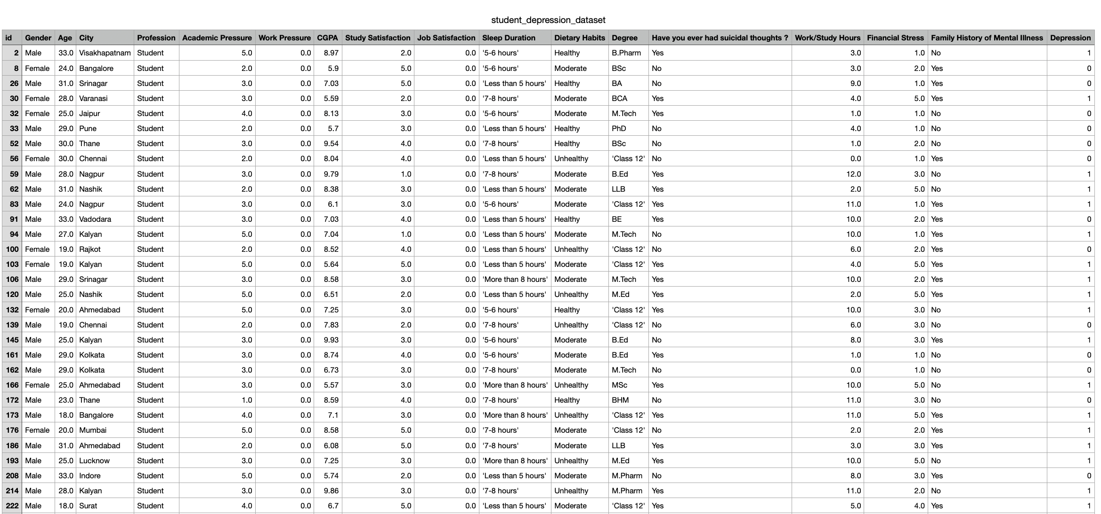
Dataset Overview
Notes:
a dataset of 27,901 university student records with depression as the primary outcome variable.

Slide 5
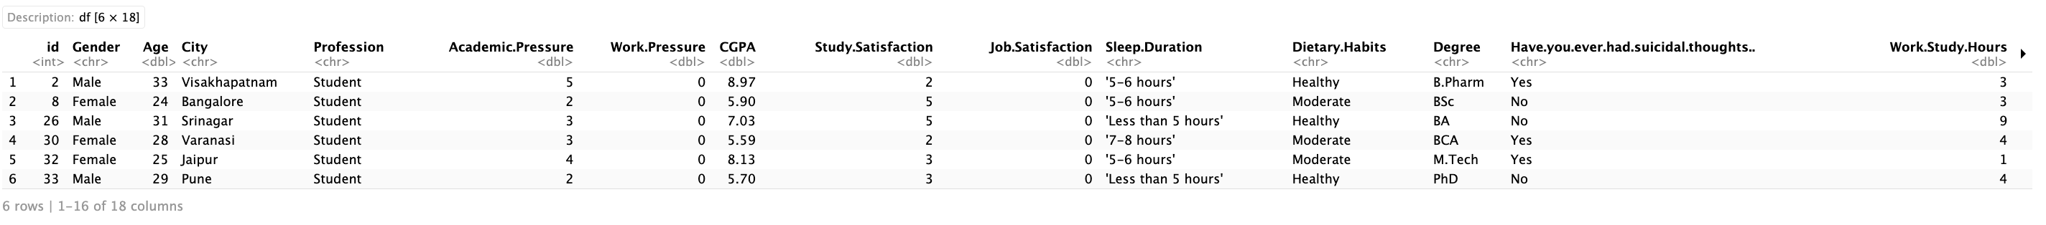
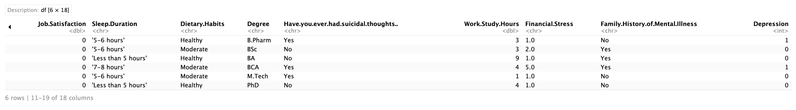
Dataset Overview

Slide 6
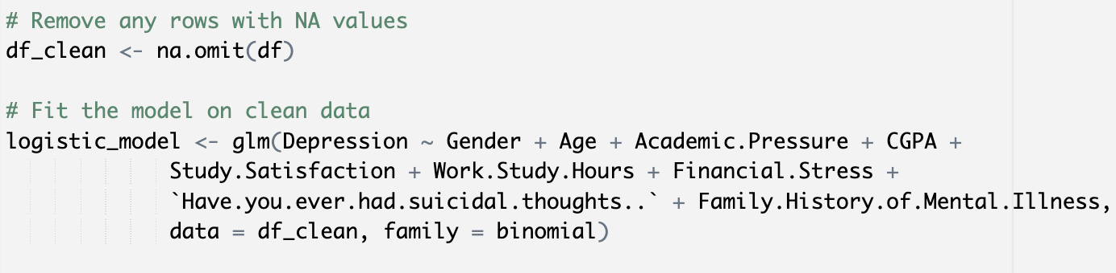
Analytical Approach
Data Preparation:
Rows with missing values were removed using na.omit()
Categorical variables were treated as factors and handled natively by the model
Model: Logistic Regression
Evaluated using Confusion Matrix, ROC Curve, AUC, and Odds Ratios

Slide 7
Hypothesis Tested
Null Hypothesis (H0): The predictors have no significant effect on depression.
Alternative Hypothesis (HA): At least one predictor significantly affects depression.
Notes:
In logistic regression, we test the following hypotheses:
• Null Hypothesis (H0): The predictors have no significant effect on the probability of depression. In other words, none of the variables in the model contribute meaningfully to the prediction of depression.
• Alternative Hypothesis (HA): At least one predictor significantly affects the probability of depression. This means that some variables have a significant relationship with the outcome, which can help in predicting depression.

Slide 8
Assumptions of Logistic Regression
Linearity of the Logit:
Relationship between predictors and log-odds is linear.
Independence of Errors:
Residuals should be independent.
No Multicollinearity:
Predictors should not be highly correlated.
Sufficient Sample Size:
Logistic regression requires a sufficiently large sample size.

Slide 9
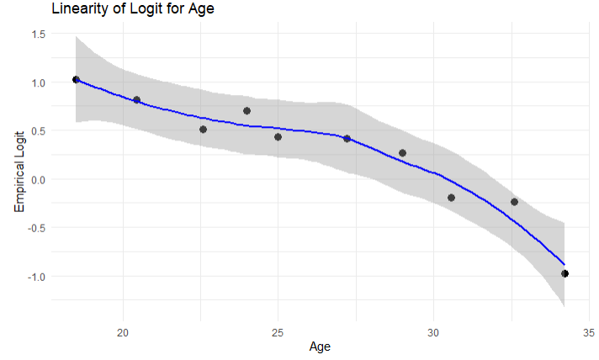
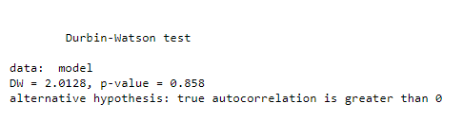
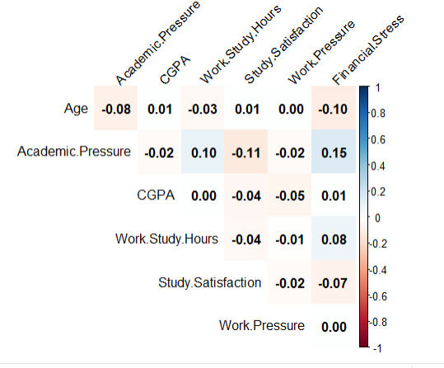
Examples of Assumptions
Notes:
There were lots of relevant variables. This is just one example of how we checked some of the assumptions.
We checked for Linearity of the logit.
We checked for Independence of Errors by using a Durbin-Watson test, and with a p-value of 0.585 we can determine that the errors are independent.
To check for multicollinearity we checked to find out if any of the predictors were highly correlated. And from this heat map we can see that they are not.
And finally we wanted to make sure our dataset was of sufficient sample size. And it is. =)

Slide 10
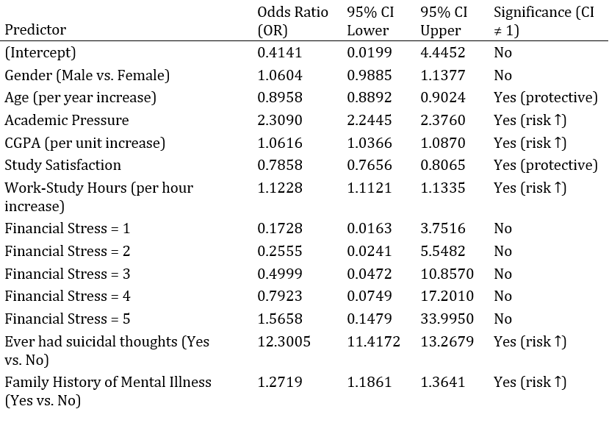
Odds Ratio Analysis
Notes:
One of the most important results of a logistic regression model is the odds ratio (OR), which helps interpret the effect of each predictor on the likelihood of depression. The odds ratio tells us how the odds of depression change for each unit increase in the predictor.
For example:
• Age (per additional year) has an odds ratio of 0.8958, meaning older students are less likely to be depressed.
• Academic Pressure has an odds ratio of 2.3090, indicating that higher academic pressure significantly increases the odds of depression.
• Suicidal Thoughts is the most significant predictor with an odds ratio of 12.3005, showing that students who have suicidal thoughts are more than 12 times more likely to suffer from depression.
These results provide actionable insights into which factors most strongly influence student depression.
### Interpretations
- **Odds Ratio (OR):**
- Values greater than 1 indicate increased odds of the outcome for that predictor.
- Values less than 1 indicate decreased odds (protective effect).
- **Significant Predictors:**
- **Risk Factors (OR > 1 and statistically significant):**
- **Academic Pressure (OR = 2.31):** Higher academic pressure increases the odds of the outcome.
- **CGPA (OR = 1.06):** Increases in CGPA are associated with slightly higher odds of the outcome.
- **Work‐Study Hours (OR = 1.12):** More work-study hours increase the odds.
- **Ever had suicidal thoughts (OR = 12.30):** Strongly increases the odds.
- **Family History of Mental Illness (OR = 1.27):** Increases the odds.
- **Protective Factors (OR < 1 and statistically significant):**
- **Age (OR = 0.90):** Older age decreases the odds.
- **Study Satisfaction (OR = 0.79):** Higher satisfaction is associated with lower odds.
- **Non-significant Predictors:**
- **Gender (Male vs. Female) and Financial Stress levels (1 to 5):** Their 95% confidence intervals include 1, implying no statistically significant effect.

Slide 11
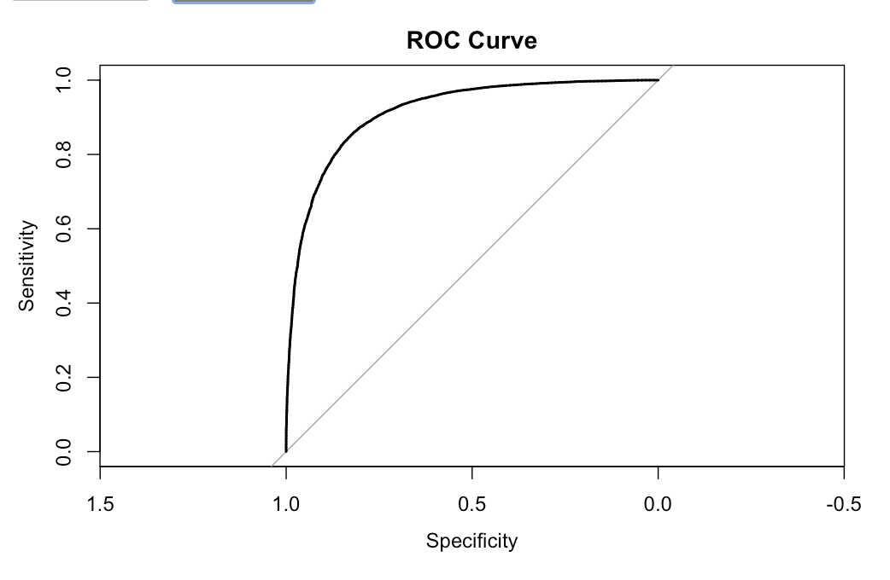
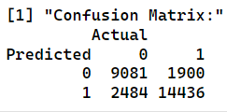
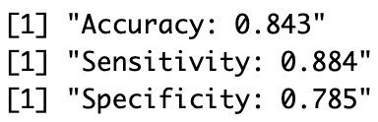
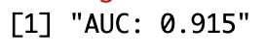
Logistic Regression Model
Notes:
Logistic regression is a statistical method used when the dependent variable is binary—such as the presence or absence of depression. Unlike linear regression, which predicts continuous outcomes, logistic regression predicts the probability of an event occurring (e.g., being depressed). The logistic regression model calculates the log-odds of the dependent variable (depression) as a linear function of the independent variables (predictors). The formula for the model looks like this:
logit(P)=β0+β1×Gender+β2×Age+…\text{logit}(P) = \beta_0 + \beta_1 \times \text{Gender} + \beta_2 \times \text{Age} + \dotslogit(P)=β0​+β1​×Gender+β2​×Age+…
Where logit(P)\text{logit}(P)logit(P) is the log-odds of depression, and the β\betaβ coefficients represent the influence of each predictor.
Model Evaluation:
After fitting the model, we evaluate its performance using metrics such as accuracy, sensitivity, specificity, and AUC (Area Under the Curve). These metrics tell us how well the model can predict depression:
• Accuracy tells us the proportion of correct predictions.
• Sensitivity (also called recall) measures the model's ability to correctly identify students who are depressed.
• Specificity measures the model’s ability to identify students who are not depressed.
• AUC provides an overall measure of model performance, where a value of 1 indicates perfect prediction and a value of 0.5 indicates no better than random guessing.
In our model, the AUC was 0.915, indicating excellent model discrimination, meaning the model performs well at distinguishing between students who are depressed and those who are not.

Slide 12
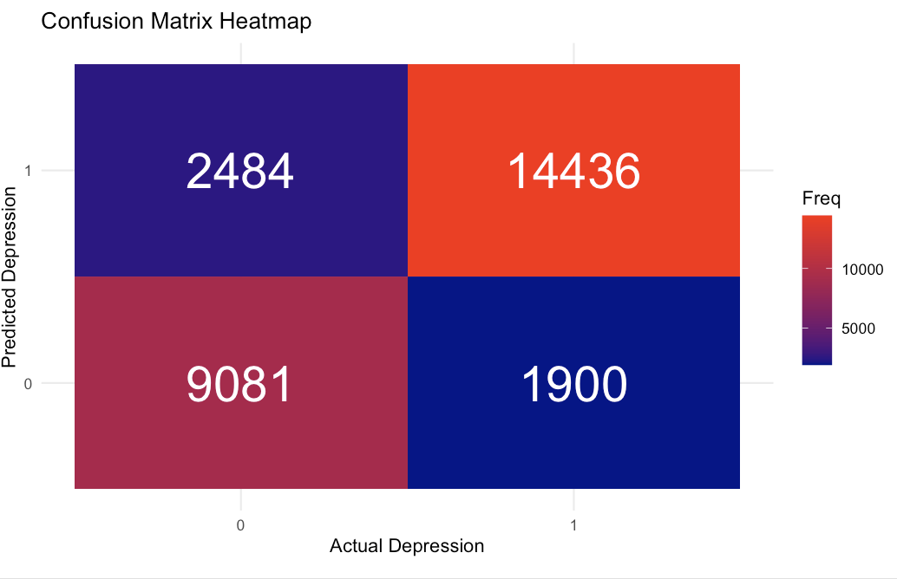
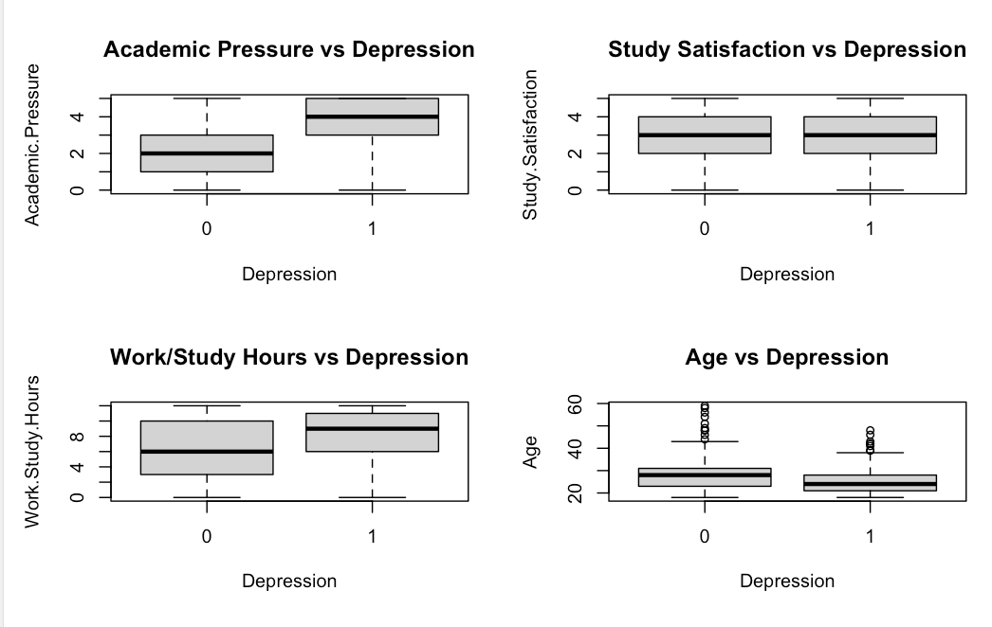
Confusion Matrix
Notes:
## Diagnostic Plot Analysis
### Visual Diagnostics
The diagnostic plots reveal:
- **Normal Q-Q Plot**: Shows some deviation from normality at the tails
- **Residuals vs Fitted**: Shows relatively even spread around zero
- **Scale-Location**: Shows relatively constant spread of standardized residuals
- **Distribution of Residuals**: Shows approximate symmetry but with some deviation from normal distribution

Slide 13
Key Findings
Suicidal thoughts are the most significant predictor of depression, with students who have suicidal thoughts being over 12 times more likely to be depressed.
A family history of mental illness slightly increases the likelihood of depression, but it is not as strong as other factors.
Academic pressure and increased work/study hours significantly contribute to depression risk.
Older students and those with higher study satisfaction have a lower likelihood of depression.
Notes:
From the model's results, several key insights emerge:
• Suicidal thoughts are the most significant predictor of depression, with students who have suicidal thoughts being over 12 times more likely to be depressed.
• Academic pressure and increased work/study hours significantly contribute to depression risk.
• Older students and those with higher study satisfaction have a lower likelihood of depression.
• A family history of mental illness slightly increases the likelihood of depression, but it is not as strong as other factors.
These insights can guide interventions to address the most prominent risk factors for student depression.

Slide 14
Recommendations for Interventions
Mental Health Screenings: Early screenings for psychological distress, especially suicidal ideation.
Support Systems: Expand counseling, stress management programs, and peer support networks.
Academic Reform: Reevaluate curriculum demands and reduce grading pressure.
Future Research: Investigate gender-based differences and explore interaction effects between variables.

Slide 15
Impact on Business Models
Healthcare Platforms
Employee Wellness Programs
Educated-Related Mental Health Services
Insurance & Managed Care Models
Notes:
Based on the diagnostic plots and model assumptions for the depression study, the findings can influence several business models:
- **Healthcare Platforms**:
The study's insights may enable platforms offering mental health services to tailor interventions and predictive analytics, improving user outcomes through early detection and personalized therapy.
- **Employee Wellness Programs**:
Organizations investing in employee wellness might leverage these findings to implement mental health initiatives, screen for potential risks, and proactively offer support to improve productivity and wellbeing.
- **Education-Related Mental Health Services**:
Educational institutions and related service providers can develop targeted programs for student mental health support, using the model to identify high-risk groups and deploy timely preventive measures.
- **Insurance and Managed Care Models**:
Insurers may incorporate these predictive models to design better mental health coverage plans and proactively manage the costs associated with mental health treatments.
These business models can benefit from integrating predictive insights from the study, leading to improved service targeting, cost reduction, and enhanced overall outcomes.

Slide 16
Conclusion
Logistic Regression Identified Key Predictors of Student Depression
Model Performance: AUC: 0.915
Top Predictors:
Suicidal thoughts – strongest
Academic pressure and long work/study hours – increased risk
Older age and higher study satisfaction - decreased risk
Family history of mental illness – modest risk
Notes:
In conclusion, logistic regression has proven to be an effective tool for identifying key predictors of depression among students. With an AUC of 0.915, the model shows strong predictive power, helping to pinpoint the most significant risk factors for depression. The insights gained from this analysis can inform university policies and mental health interventions, ultimately improving the well-being of students.

Slide 17
BONUS
Net Reclassification Improvement (NRI)
A metric that helps quantify how much a new model improves risk classification compared to a baseline model.
Notes:
For individuals with the event (e.g., depressed) the NRI is calculated as the percentage who move to a higher risk category minus the percentage who move to a lower risk category.
For individuals without the event (e.g., not depressed) it is the percentage who move to a lower risk category minus the percentage who move to a higher risk.
The total NRI is the sum of these two differences.
An NRI value greater than 0 indicates that the new model has improved classification, while a negative NRI suggests a decline in performance, making it a useful measure for model comparison beyond traditional statistics like the AUC.

Slide 18
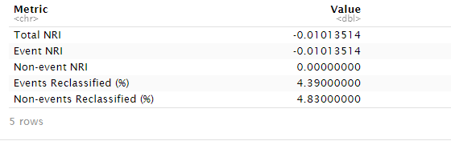
BONUS
Notes:
NRI Results Interpretation:
Total NRI: -0.0101 (1.01% decrease in overall classification performance)
Events (Depressed Students):
4.39% of depressed students were reclassified
Net movement showed a -1.01% decrease in correct classification
Non-events (Non-depressed Students):
4.83% of non-depressed students were reclassified
No net change in classification accuracy (0%)
Clinical Impact:
The addition of sleep_hours as a predictor resulted in:
More reclassification movement (4.39-4.83% of cases moved)
Slightly decreased accuracy for depressed students
No change in accuracy for non-depressed students
The negative NRI suggests the new predictor may not improve the model's clinical utility

Slide 19

Thank you for listening!

